Slide 1

Loops

Slide 2

Loops
So far we have seen that Python executes code in a sequence and each block of code is executed once.
Loops allow us to execute a block of code several times.

Slide 3
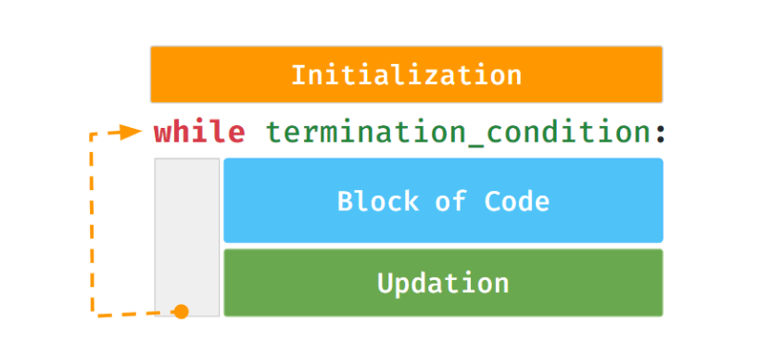
While Loop
Allows us to execute a block of code several times as long as the condition is True.

Slide 4
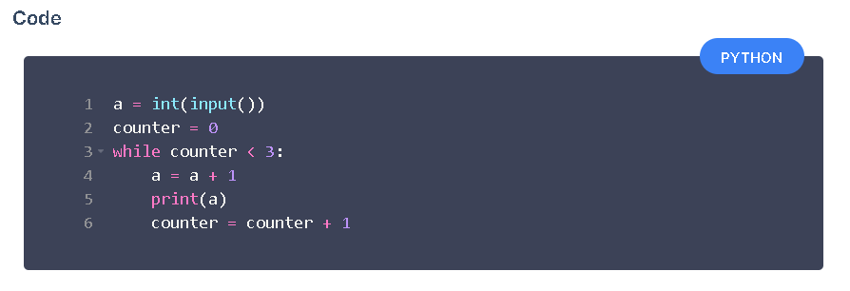
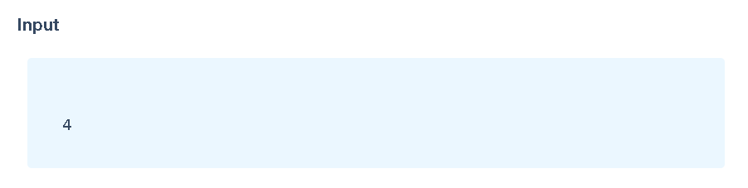
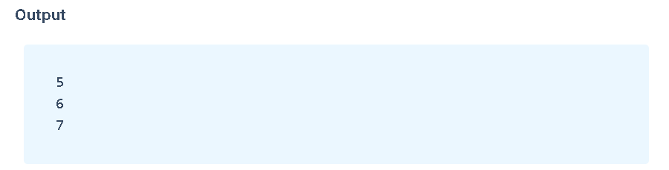
While Loop Example
The following code snippet prints the next three consecutive numbers after a given number.

Slide 5
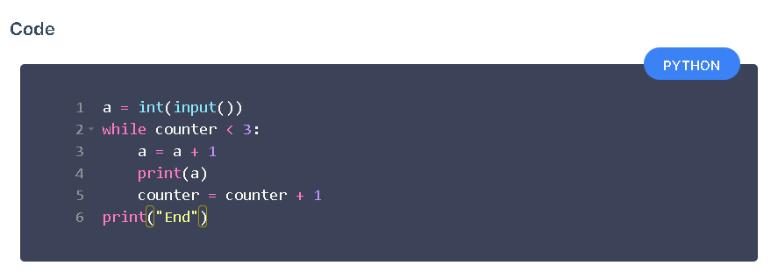
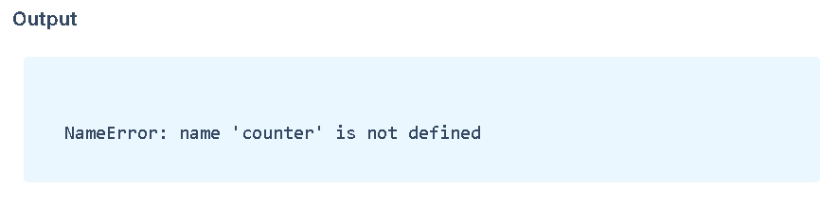
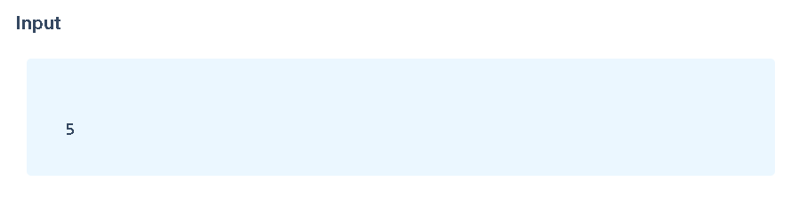
Possible Mistakes 1. Missing Initialization

Slide 6
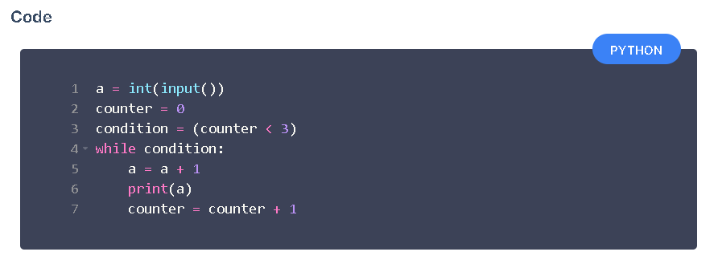
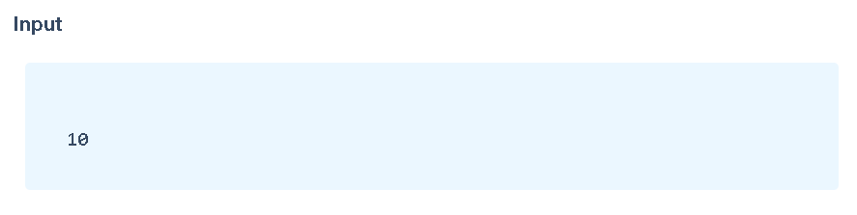
2. Incorrect Termination Condition
Output
The above code runs into an infinite loop.
While block will keep repeating as the value in condition variable is True .

Slide 7
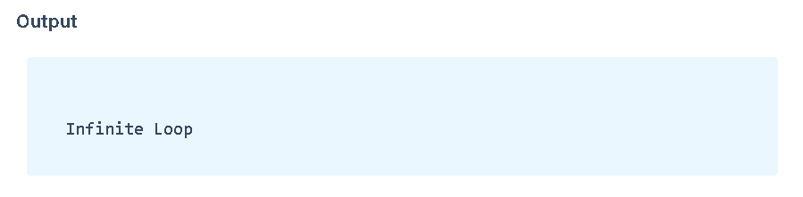
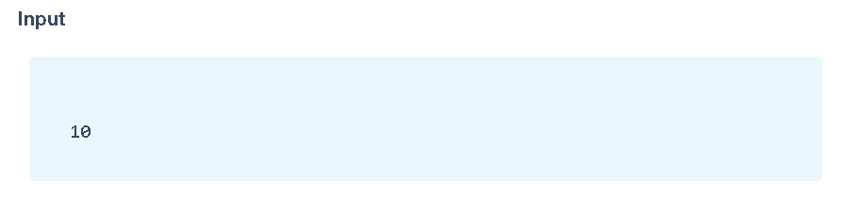
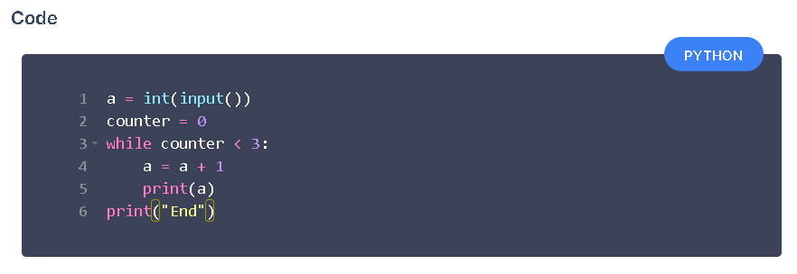
3. Not Updating Counter Variable

Slide 8

For Loop

Slide 9
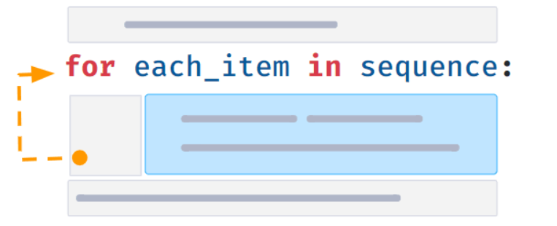
For Loop
For statement iterates over each item of a sequence.

Slide 10

Examples of sequences:
Sequence of Characters (string)
Sequence of numbers, etc.

Slide 11
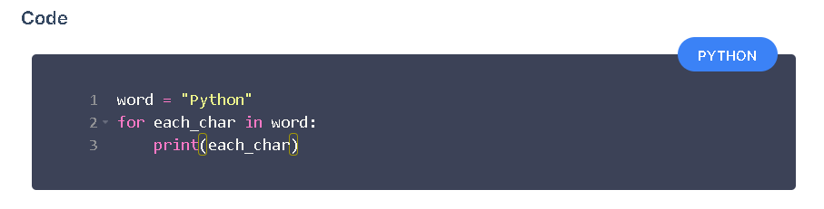
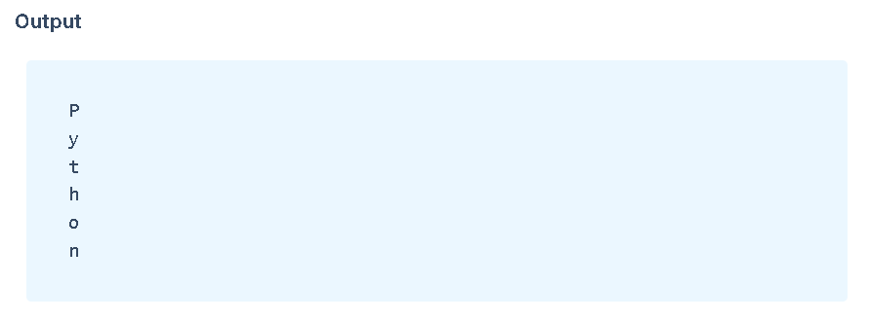
For Syntax

Slide 12

Range
Generates a sequence of integers starting from 0.
Syntax: range(n)
Stops before n (n is not included).

Slide 13
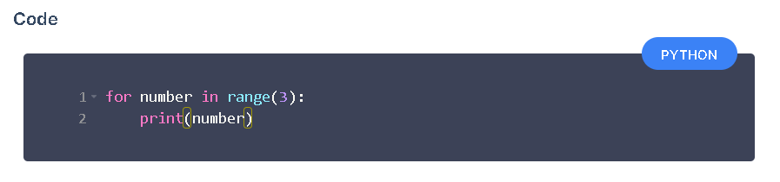
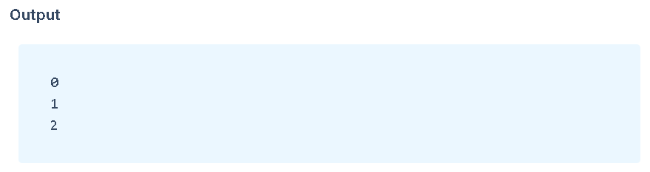
Example

Slide 14
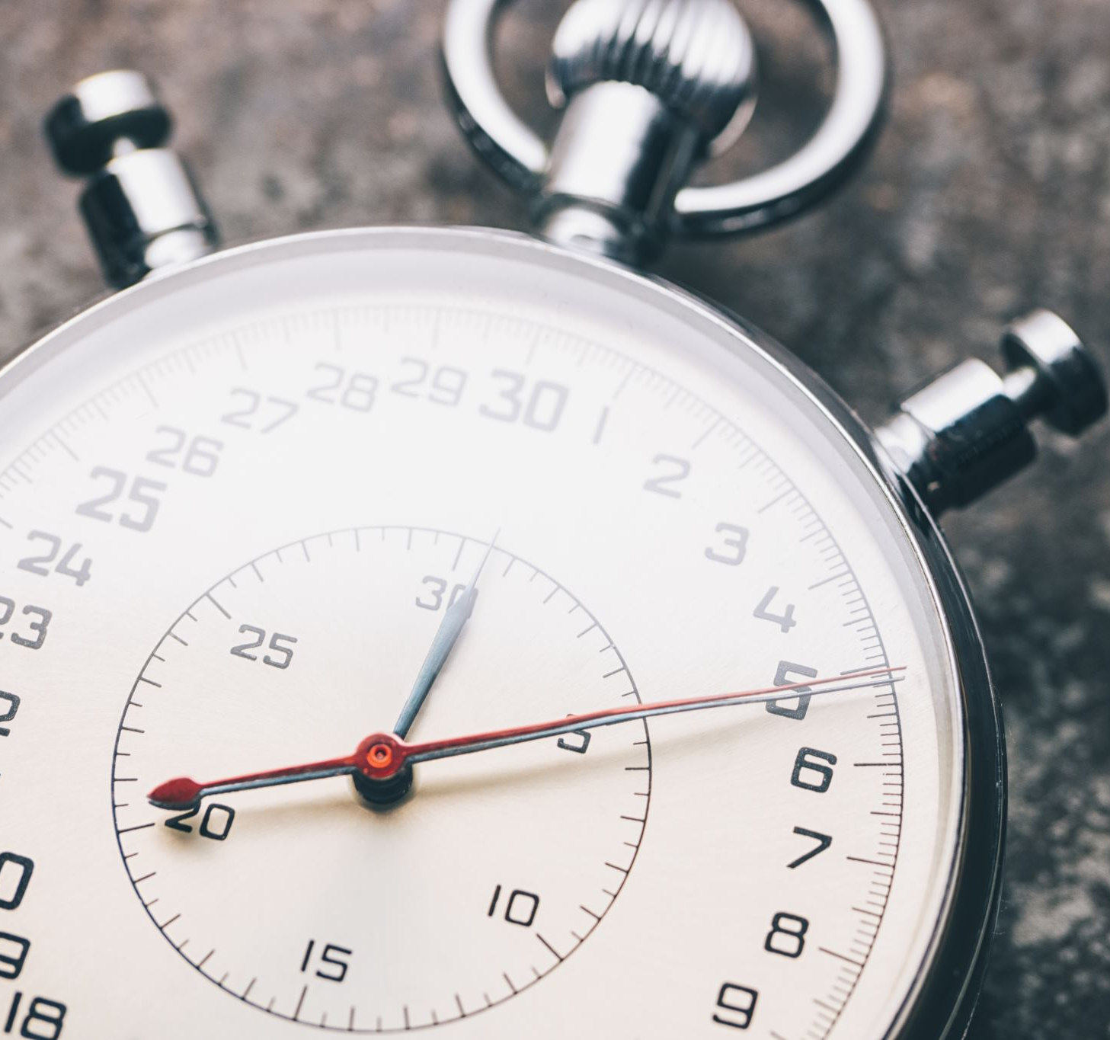
Range with Start and End
Generates a sequence of numbers starting from start
Syntax: range(start, end)
Stops before end (end is not included).

Slide 15
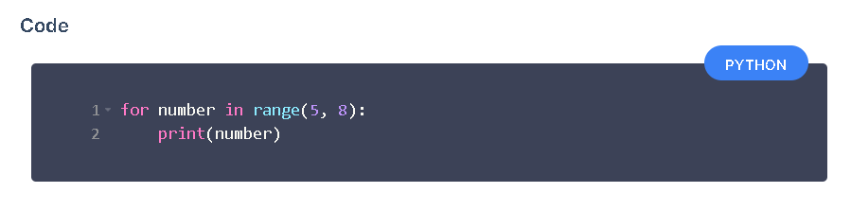
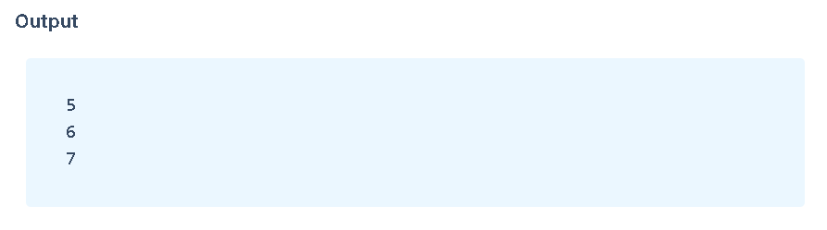
Example

